Slide 1
Recurrences
Dr.P.Vetrivelan

Slide 2
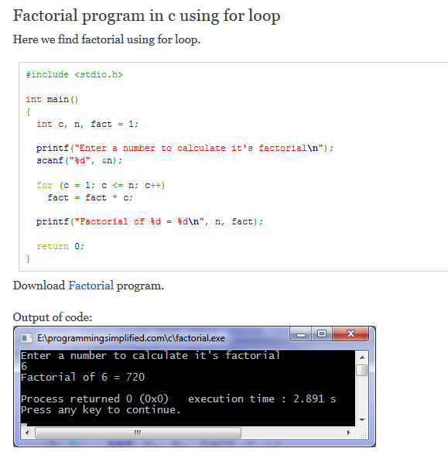
Factorial - Looping

Slide 3
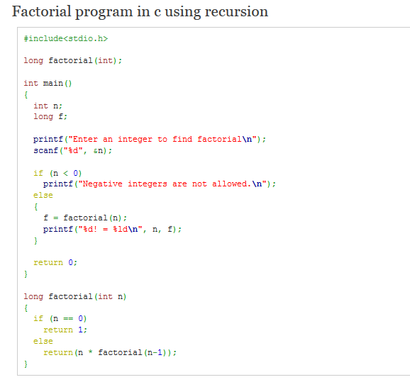
Factorial - Recursion

Slide 4
Modeling with Recurrence Relations
Example:
Someone deposits $10,000 in a savings account at a bank yielding 5% per year with interest compounded annually. How much money will be in the account after 30 years?
Solution:
Let P_{n} denote the amount in the account after n years.
How can we determine P_{n} on the basis of P_{n-1}?

Slide 5
Modeling with Recurrence Relations
We can derive the following recurrence relation:
P_{n} = P_{n-1} + 0.05P_{n-1} = 1.05P_{n-1}.
The initial condition is P₀ = 10,000.
Then we have:
P₁ = 1.05P₀
P₂ = 1.05P₁ = (1.05)²P₀
P₃ = 1.05P₂ = (1.05)³P₀
…
P_{n} = 1.05P_{n-1} = (1.05)^{n}P₀
We now have a formula to calculate P_{n} for any natural number n and can avoid the iteration.

Slide 6
Modeling with Recurrence Relations
Let us use this formula to find P₃₀ under the
initial condition P₀ = 10,000:
P₃₀ = (1.05)³⁰⋅10,000 = 43,219.42
After 30 years, the account contains $43,219.42.

Slide 7
Solving Recurrences

Slide 8
Recurrences and Running Time
An equation or inequality that describes a function in terms of its value on smaller inputs.
T(n) = T(n-1) + n
Recurrences arise when an algorithm contains recursive calls to itself
What is the actual running time of the algorithm?
Need to solve the recurrence
Find an explicit formula of the expression
Bound the recurrence by an expression that involves n

Slide 9
Example Recurrences
T(n) = T(n-1) + n Θ(n²)
Recursive algorithm that loops through the input to eliminate one item
T(n) = T(n/2) + c Θ(lgn)
Recursive algorithm that halves the input in one step
T(n) = T(n/2) + n Θ(n)
Recursive algorithm that halves the input but must examine every item in the input
T(n) = 2T(n/2) + 1 Θ(n)
Recursive algorithm that splits the input into 2 halves and does a constant amount of other work

Slide 10
Recurrent Algorithms BINARY-SEARCH
for an ordered array A, finds if x is in the array A[lo…hi]
Alg.: BINARY-SEARCH (A, lo, hi, x)
if (lo > hi)
return FALSE
mid ← ⎣(lo+hi)/2⎦
if x = A[mid]
return TRUE
if ( x < A[mid] )
BINARY-SEARCH (A, lo, mid-1, x)
if ( x > A[mid] )
BINARY-SEARCH (A, mid+1, hi, x)
1
2
3
4
5
6
7
8
2
3
5
7
9
10
11
12
mid
lo
hi

Slide 11
Example
A[8] = {1, 2, 3, 4, 5, 7, 9, 11}
lo = 1 hi = 8 x = 7
1
2
3
4
5
6
7
8
1
2
3
4
5
7
9
11
mid = 4, lo = 5, hi = 8
5
6
7
8
1
2
3
4
5
7
9
11
mid = 6, A[mid] = x Found!

Slide 12
Another Example
A[8] = {1, 2, 3, 4, 5, 7, 9, 11}
lo = 1 hi = 8 x = 6
1
2
3
4
5
6
7
8
1
2
3
4
5
7
9
11
mid = 4, lo = 5, hi = 8
low
high
1
2
3
4
5
7
9
11
mid = 6, A[6] = 7, lo = 5, hi = 5
low
high
1
2
3
4
5
7
9
11
mid = 5, A[5] = 5, lo = 6, hi = 5
NOT FOUND!
1
2
3
4
5
7
9
11
high
low

Slide 13
Analysis of BINARY-SEARCH
Alg.: BINARY-SEARCH (A, lo, hi, x)
if (lo > hi)
return FALSE
mid ← ⎣(lo+hi)/2⎦
if x = A[mid]
return TRUE
if ( x < A[mid] )
BINARY-SEARCH (A, lo, mid-1, x)
if ( x > A[mid] )
BINARY-SEARCH (A, mid+1, hi, x)
T(n) = c +
T(n) – running time for an array of size n
constant time: c₁
constant time: c₂
constant time: c₃
same problem of size n/2
same problem of size n/2
T(n/2)

Slide 14
Methods for Solving Recurrences
Substitution method
Iteration method
Change Variable
Recursion tree method
Master method

Slide 15
The substitution method
Guess a solution
Use induction to prove that the solution works

Slide 16
Substitution method
Guess a solution
T(n) = O(g(n))
Induction goal: apply the definition of the asymptotic notation
T(n) ≤ d g(n), for some d > 0 and n ≥ n₀
Induction hypothesis: T(k) ≤ d g(k) for all k < n
Prove the induction goal
Use the induction hypothesis to find some values of the constants d and n₀ for which the induction goal holds
(strong induction)

Slide 17
Example: Binary Search
T(n) = c + T(n/2)
Guess: T(n) = O(lgn)
Induction goal: T(n) ≤ d lgn, for some d and n ≥ n₀
Induction hypothesis: T(n/2) ≤ d lg(n/2)
Proof of induction goal:
T(n) = T(n/2) + c ≤ d lg(n/2) + c
= d lgn – d + c ≤ d lgn
if: – d + c ≤ 0, d ≥ c
Base case?

Slide 18
Example 2
T(n) = T(n-1) + n
Guess: T(n) = O(n²)
Induction goal: T(n) ≤ c n², for some c and n ≥ n₀
Induction hypothesis: T(n-1) ≤ c(n-1)² for all k < n
Proof of induction goal:
T(n) = T(n-1) + n ≤ c (n-1)² + n
= cn² – (2cn – c - n) ≤ cn²
if: 2cn – c – n ≥ 0 ⇔ c ≥ n/(2n-1) ⇔ c ≥ 1/(2 – 1/n)
For n ≥ 1 ⇒ 2 – 1/n ≥ 1 ⇒ any c ≥ 1 will work

Slide 19
Example 3
T(n) = 2T(n/2) + n
Guess: T(n) = O(nlgn)
Induction goal: T(n) ≤ cn lgn, for some c and n ≥ n₀
Induction hypothesis: T(n/2) ≤ cn/2 lg(n/2)
Proof of induction goal:
T(n) = 2T(n/2) + n ≤ 2c (n/2)lg(n/2) + n
= cn lgn – cn + n ≤ cn lgn
if: - cn + n ≤ 0 ⇒ c ≥ 1
Base case?

Slide 20
The Iteration Method
Convert the recurrence into a summation and try to bound it using known series
Iterate the recurrence until the initial condition is reached.
Use back-substitution to express the recurrence in terms of n and the initial (boundary) condition.

Slide 21
The Iteration Method
T(n) = c + T(n/2)
T(n) = c + T(n/2)
= c + c + T(n/4)
= c + c + c + T(n/8)
Assume n = 2^{k}
T(n) = c + c + … + c + T(1)
= clgn + T(1)
= Θ(lgn)
T(n/2) = c + T(n/4)
T(n/4) = c + T(n/8)
k times

Slide 22
Iteration Method – Example
T(n) = n + 2T(n/2)
T(n) = n + 2T(n/2)
= n + 2(n/2 + 2T(n/4))
= n + n + 4T(n/4)
= n + n + 4(n/4 + 2T(n/8))
= n + n + n + 8T(n/8)
… = in + 2^{i}T(n/2^{i})
= kn + 2^{k}T(1)
= nlgn + nT(1) = Θ(nlgn)
Assume: n = 2^{k}
T(n/2) = n/2 + 2T(n/4)

Slide 23
Changing variables
T(n) = 2T( ) + lgn
Rename: m = lgn ⇒ n = 2^{m}
T (2^{m}) = 2T(2^{m/2}) + m
Rename: S(m) = T(2^{m})
S(m) = 2S(m/2) + m ⇒ S(m) = O(mlgm) (demonstrated before)
T(n) = T(2^{m}) = S(m) = O(mlgm)=O(lgnlglgn)
Idea: transform the recurrence to one that you have seen before

Slide 24
The recursion-tree method
Convert the recurrence into a tree:
Each node represents the cost incurred at various levels of recursion
Sum up the costs of all levels
Used to “guess” a solution for the recurrence

Slide 25
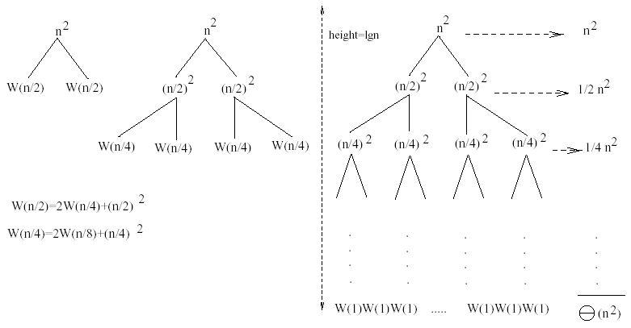
Example 1
W(n) = 2W(n/2) + n²
Subproblem size at level i is: n/2^{i}
Subproblem size hits 1 when 1 = n/2^{i} ⇒ i = lgn
Cost of the problem at level i = (n/2^{i})² No. of nodes at level i = 2^{i}
Total cost:
⇒ W(n) = O(n²)

Slide 26
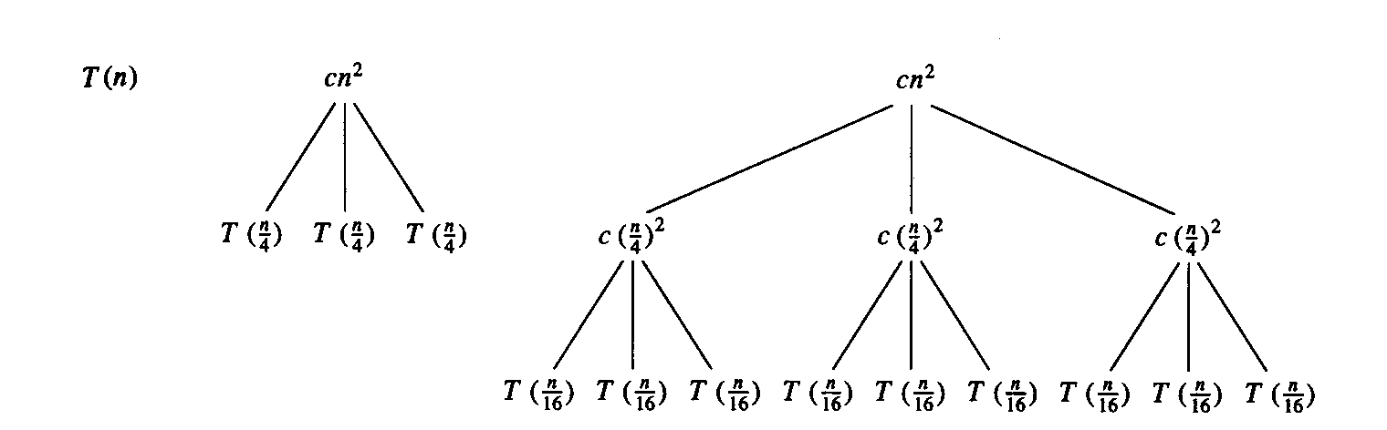
Example 2
E.g.: T(n) = 3T(n/4) + cn²
Subproblem size at level i is: n/4^{i}
Subproblem size hits 1 when 1 = n/4^{i} ⇒ i = log₄n
Cost of a node at level i = c(n/4^{i})²
Number of nodes at level i = 3^{i} ⇒ last level has 3^{log}₄^{n} = n^{log}₄³ nodes
Total cost:
⇒ T(n) = O(n²)

Slide 27
Example 2 - Substitution
T(n) = 3T(n/4) + cn²
Guess: T(n) = O(n²)
Induction goal: T(n) ≤ dn², for some d and n ≥ n₀
Induction hypothesis: T(n/4) ≤ d (n/4)²
Proof of induction goal:
T(n) = 3T(n/4) + cn²
≤ 3d (n/4)² + cn²
= (3/16) d n² + cn²
≤ d n² if: d ≥ (16/13)c
Therefore: T(n) = O(n²)

Slide 28
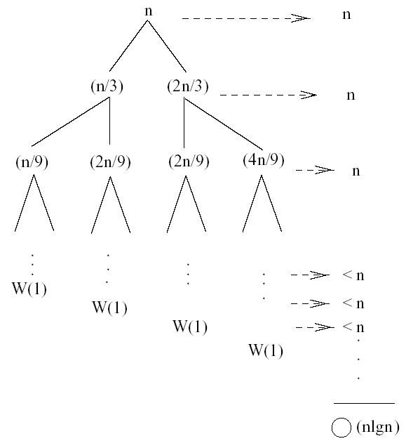
Example 3 (simpler proof)
W(n) = W(n/3) + W(2n/3) + n
The longest path from the root to a leaf is: n → (2/3)n → (2/3)² n → … → 1
Subproblem size hits 1 when 1 = (2/3)^{i}n ⇔ i=log_{3/2}n
Cost of the problem at level i = n
Total cost:
⇒ W(n) = O(nlgn)

Slide 29
Example 3
W(n) = W(n/3) + W(2n/3) + n
The longest path from the root to a leaf is: n → (2/3)n → (2/3)² n → … → 1
Subproblem size hits 1 when 1 = (2/3)^{i}n ⇔ i=log_{3/2}n
Cost of the problem at level i = n
Total cost:
⇒ W(n) = O(nlgn)

Slide 30
Example 3 - Substitution
W(n) = W(n/3) + W(2n/3) + O(n)
Guess: W(n) = O(nlgn)
Induction goal: W(n) ≤ dnlgn, for some d and n ≥ n₀
Induction hypothesis: W(k) ≤ d klgk for any K < n (n/3, 2n/3)
Proof of induction goal:
Try it out as an exercise!!
T(n) = O(nlgn)

Slide 31
Master’s method
“Cookbook” for solving recurrences of the form:
where, a ≥ 1, b > 1, and f(n) > 0
Idea: compare f(n) with n^{log}_{b}ª
f(n) is asymptotically smaller or larger than n^{log}_{b}ª by a polynomial factor n^{ε}
f(n) is asymptotically equal with n^{log}_{b}ª

Slide 32
Master’s method
“Cookbook” for solving recurrences of the form:
where, a ≥ 1, b > 1, and f(n) > 0
Case 1: if f(n) = O(n^{log}_{b}^{a -ε}) for some ε > 0, then: T(n) = Θ(n^{log}_{b}ª)
Case 2: if f(n) = Θ(n^{log}_{b}ª), then: T(n) = Θ(n^{log}_{b}ª lgn)
Case 3: if f(n) = Ω(n^{log}_{b}^{a +ε}) for some ε > 0, and if
af(n/b) ≤ cf(n) for some c < 1 and all sufficiently large n, then:
T(n) = Θ(f(n))
regularity condition

Slide 33
Why n^{log}_{b}ª?
Case 1:
If f(n) is dominated by n^{log}_{b}ª:
T(n) = Θ(n^{log}_{b}^{n})
Case 3:
If f(n) dominates n^{log}_{b}ª:
T(n) = Θ(f(n))
Case 2:
If f(n) = Θ(n^{log}_{b}ª):
T(n) = Θ(n^{log}_{b}ª logn)
Assume n = b^{k} ⇒ k = log_{b}n
At the end of iteration i = k:

Slide 34
Examples
T(n) = 2T(n/2) + n
a = 2, b = 2, log₂2 = 1
Compare n^{log}₂² with f(n) = n
⇒ f(n) = Θ(n) ⇒ Case 2
⇒ T(n) = Θ(nlgn)

Slide 35
Examples
T(n) = 2T(n/2) + n²
a = 2, b = 2, log₂2 = 1
Compare n with f(n) = n²
⇒ f(n) = Ω(n^{1+ε}) Case 3 ⇒ verify regularity cond.
a f(n/b) ≤ c f(n)
⇔ 2 n²/4 ≤ c n² ⇒ c = ½ is a solution (c<1)
⇒ T(n) = Θ(n²)

Slide 36
Examples (cont.)
T(n) = 2T(n/2) +
a = 2, b = 2, log₂2 = 1
Compare n with f(n) = n^{1/2}
⇒ f(n) = O(n^{1-ε}) Case 1
⇒ T(n) = Θ(n)

Slide 37
Examples
T(n) = 3T(n/4) + nlgn
a = 3, b = 4, log₄3 = 0.793
Compare n^{0.793} with f(n) = nlgn
f(n) = Ω(n^{log}₄^{3+ε}) Case 3
Check regularity condition:
3∗(n/4)lg(n/4) ≤ (3/4)nlgn = c ∗f(n), c=3/4
⇒T(n) = Θ(nlgn)

Slide 38
Examples
T(n) = 2T(n/2) + nlgn
a = 2, b = 2, log₂2 = 1
Compare n with f(n) = nlgn
seems like case 3 should apply
f(n) must be polynomially larger by a factor of n^{ε}
In this case it is only larger by a factor of lgn

